Slide 1
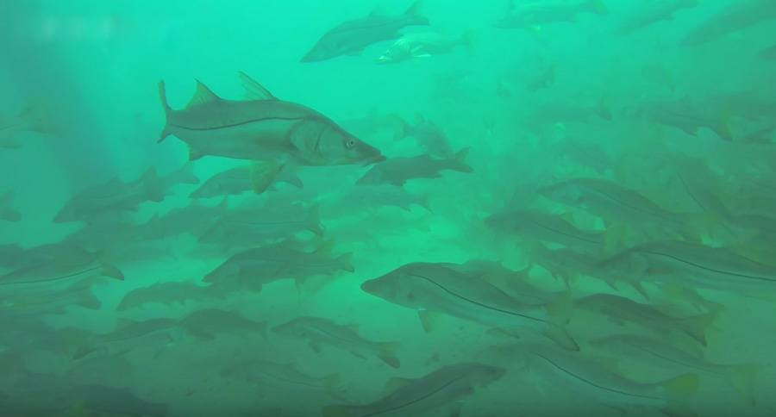

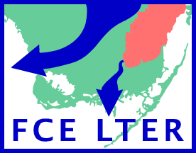

Understanding how snook respond to dynamic hydroscapes:
Synchrony vs.
Individual variation
JS Rehage, RO Santos, RE Boucek
Earth & Environment Department
Notes:
What Is the Role of Individual Variation in Tracking Temporal Heterogeneity? Hydroscapes and Everglades Common Snook

Slide 2
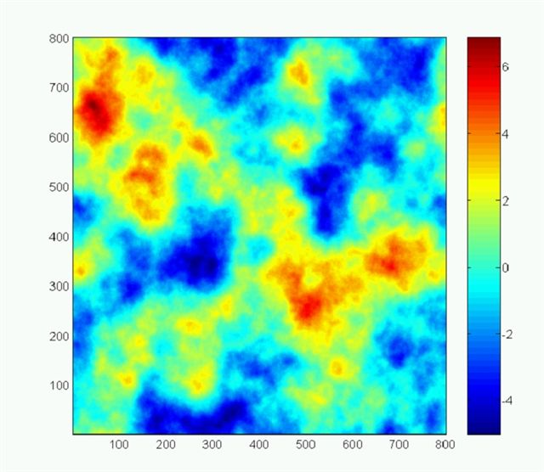
Environmental heterogeneity
Resources can be patchy in space
Notes:
Env heterogeneity is prevailant in landacapes

Slide 3
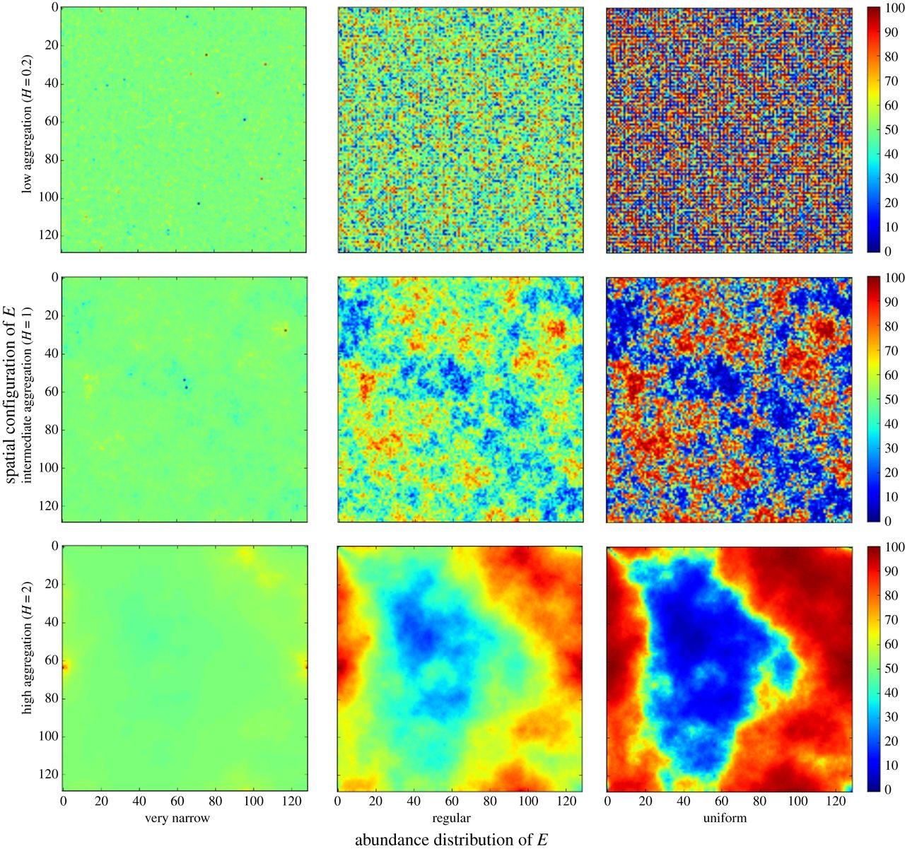
Environmental heterogeneity
And dynamic in time
T₁
T₂

Slide 4
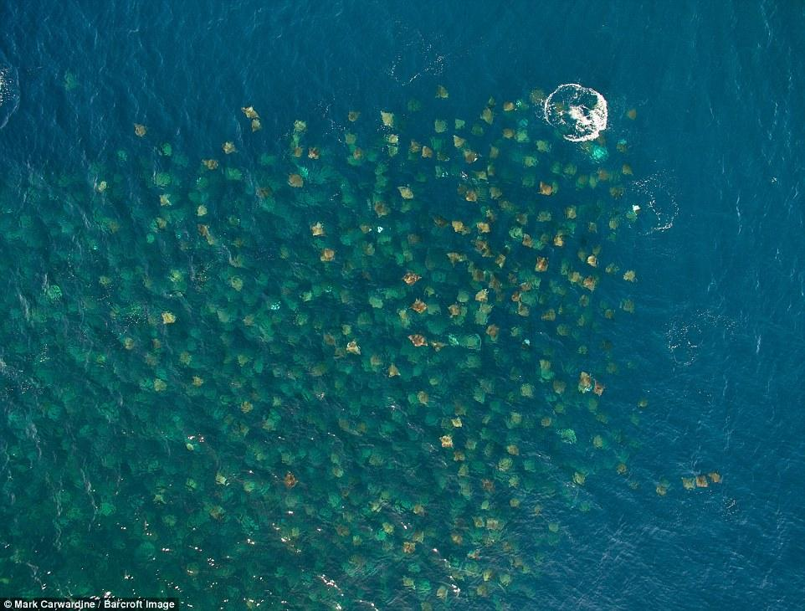
Animals track heterogeneity with movement
Devil’s Rays, Baja, MX
Notes:
http://www.earthporm.com/26-incredible-photos-animal-migration/

Slide 5
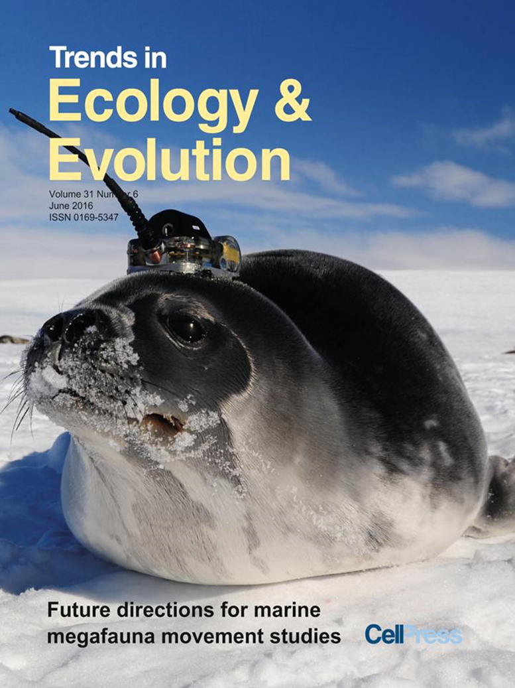
Unprecedented spatiotemporal resolution & accuracy

Slide 6
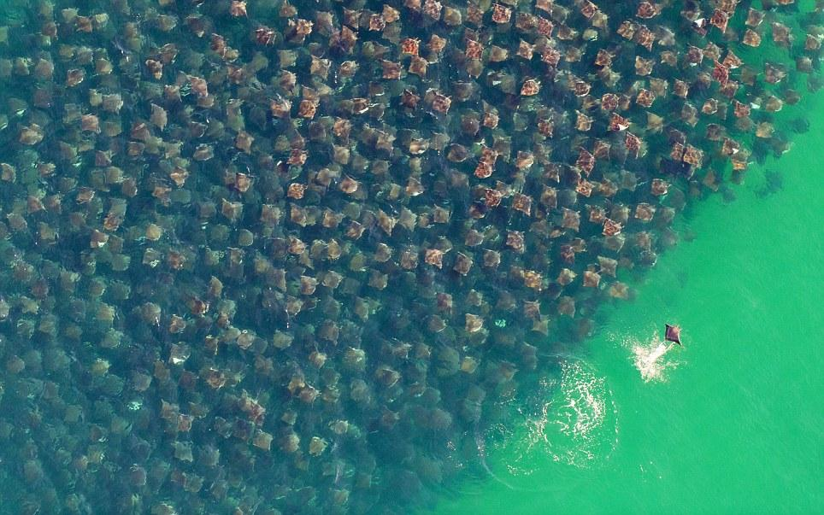
Heterogeneity in resource: synchrony in movement
xxx
Notes:
important management and conservation implications

Slide 7

But animals can also vary: intraspecific variation
Notes:
important management and conservation implications

Slide 8
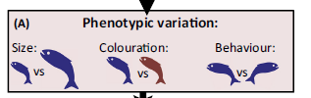
Intraspecific variation in movement
Driven by variation in traits:
Morphology
Life history
Physiology
Behavioral type (boldness, aggressiveness, sociability)
Notes:
Can generation variation in demographic
Identity of indivduals

Slide 9
Intraspecific variation in movement
Driven by variation in traits:
Morphology
Life history
Physiology
Behavioral type (boldness, aggressiveness, sociability)
Ecological & conservation implications
Demographic
parameters
Metapopulation
structure
Responses to habitat fragmentation
Notes:
Can generation variation in demographic
Identity of indivduals

Slide 10
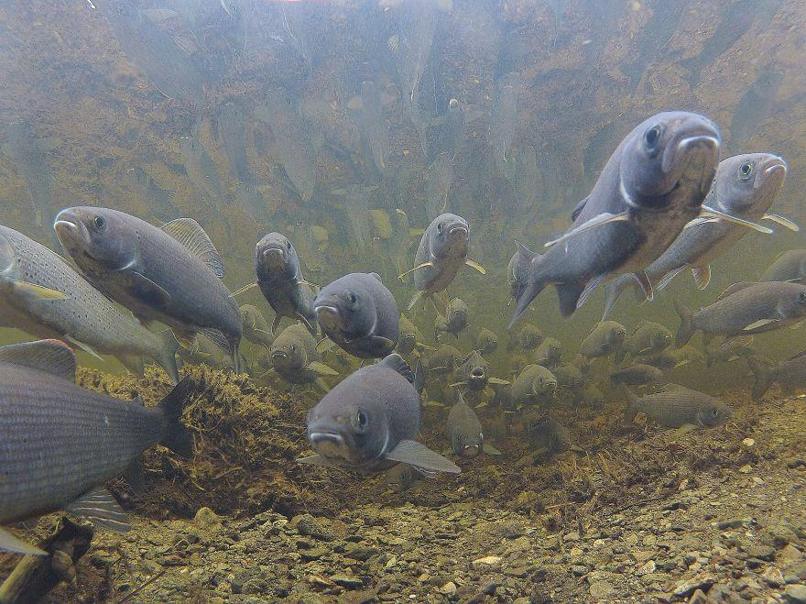
Pace of Life Hypothesis
Consistent behavioural differences covary with life history & physiology
Reale et al 2010 PTRS B
Notes:
http://www.earthporm.com/26-incredible-photos-animal-migration/

Slide 11
Pace of Life Hypothesis
Consistent behavioural differences covary with life history & physiology
FAST
Bold, antisocial
High growth rate
Low immune response
High movement
Reale et al 2010 PTRS B
Notes:
http://www.earthporm.com/26-incredible-photos-animal-migration/

Slide 12
Pace of Life Hypothesis
Consistent behavioural differences covary with life history & physiology
FAST
Bold, antisocial
High growth rate
Low immune response
High movement
SLOW
Shy, sociable
Low growth rate
High immune response
Low movement
Reale et al 2010 PTRS B
Notes:
http://www.earthporm.com/26-incredible-photos-animal-migration/

Slide 13
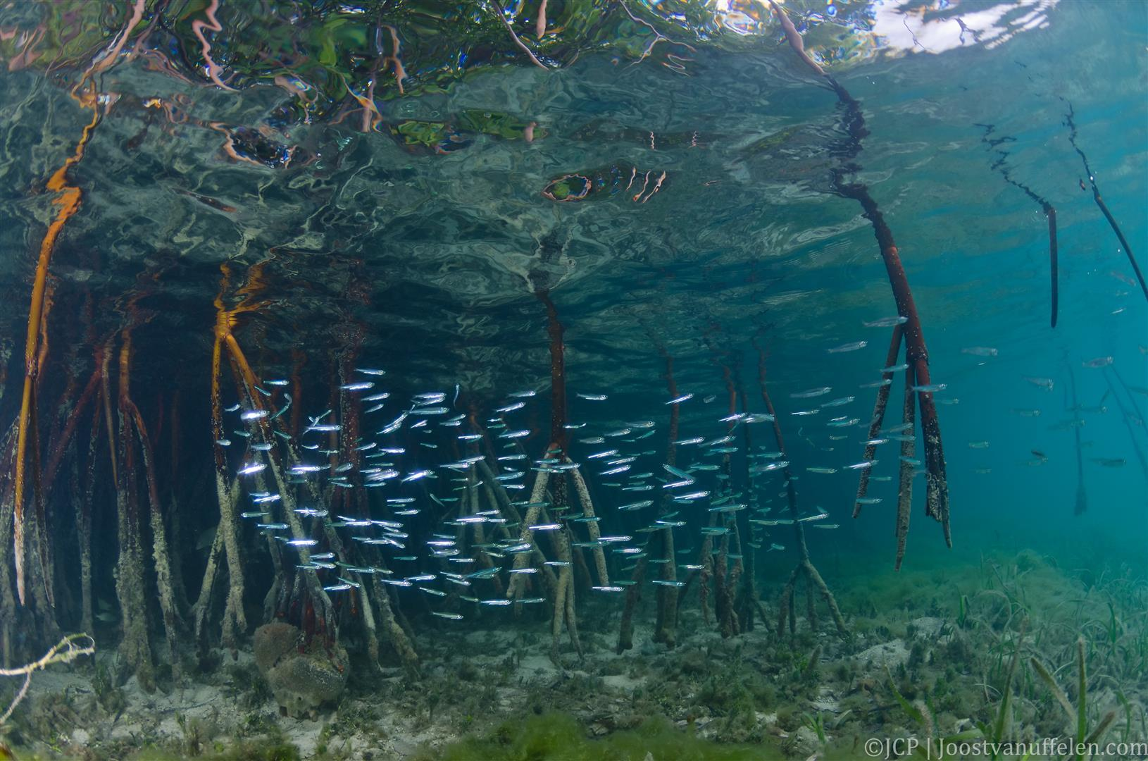
Habitat quality is patchy
- Good patches

Slide 14
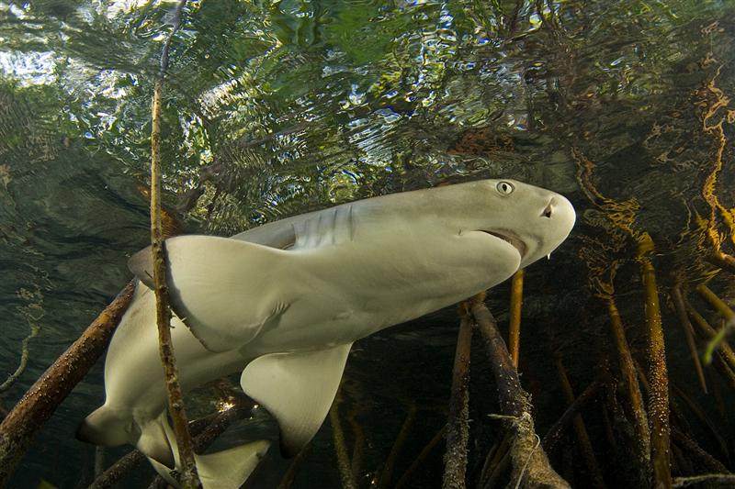
Habitat quality is patchy
- Poor patches

Slide 15
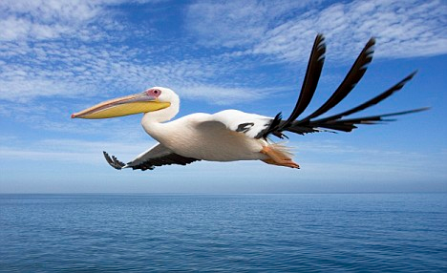
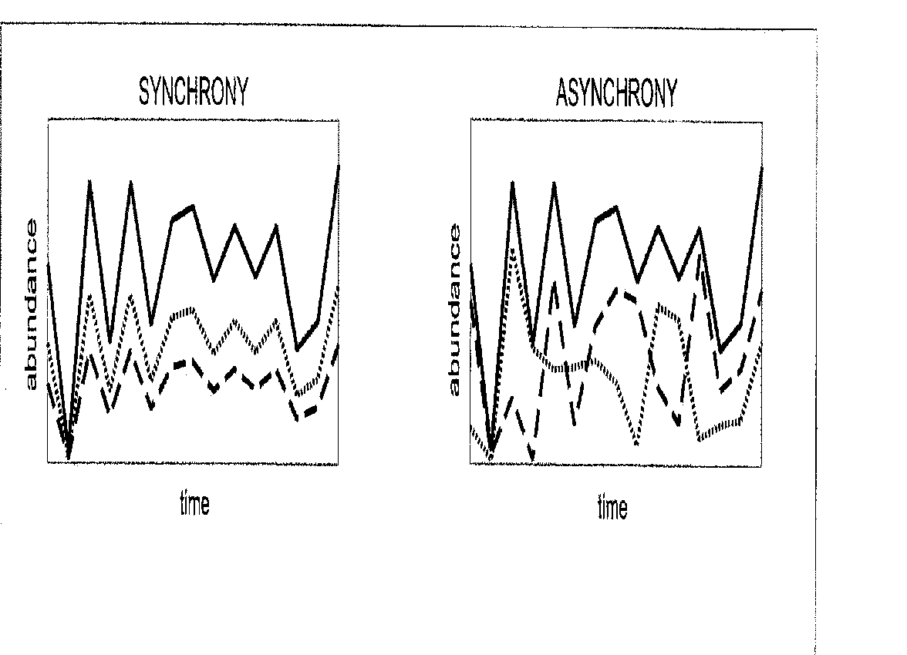

Intraspecific variation
Environmental
Heterogeneity vs.
Movement
Notes:
Space use is correlated over time

Slide 16
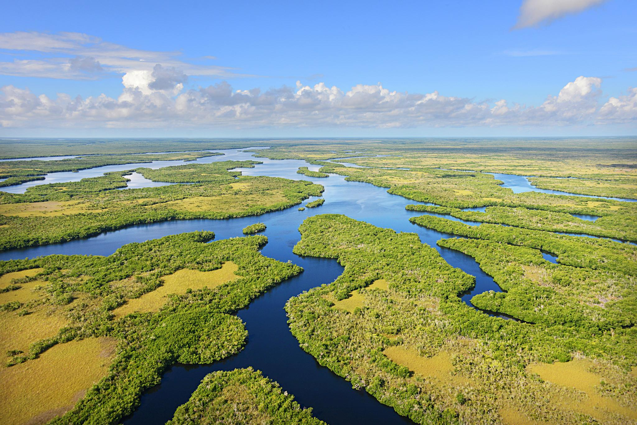
Does hydrological variation result in spatial synchrony across individuals?
Tarpon Bay
P. Cross

Slide 17
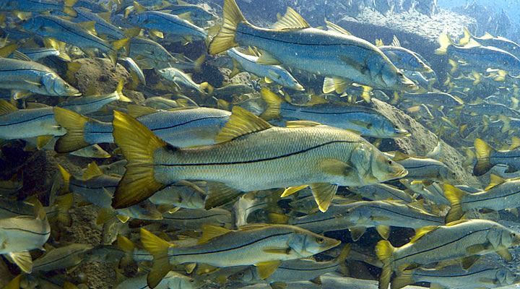
Common snook (Centropomis undecimalis)

Slide 18
Does temporal forcing cause spatial synchrony in snook movement?
Can we distinguish multiple movement strategies that lead to synchrony/asynchrony?

Slide 19
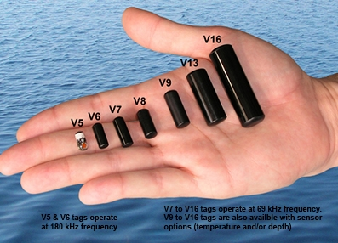
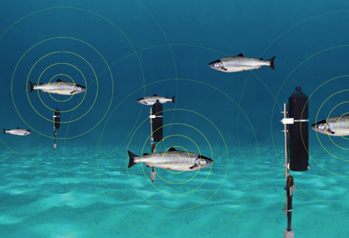
Tracked snook movement: Acoustic telemetry
Tags (internally implanted)
Hydrophones
+
Tags uniquely identify fish (last 4-7 yrs)
Hydrophones listen for tags

Slide 20
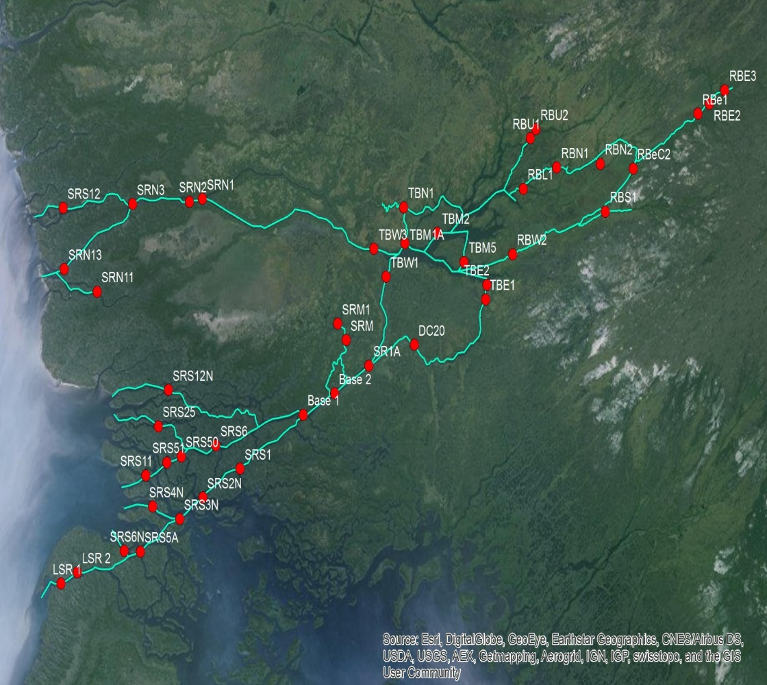
Acoustic telemetry in the Shark River

Slide 21
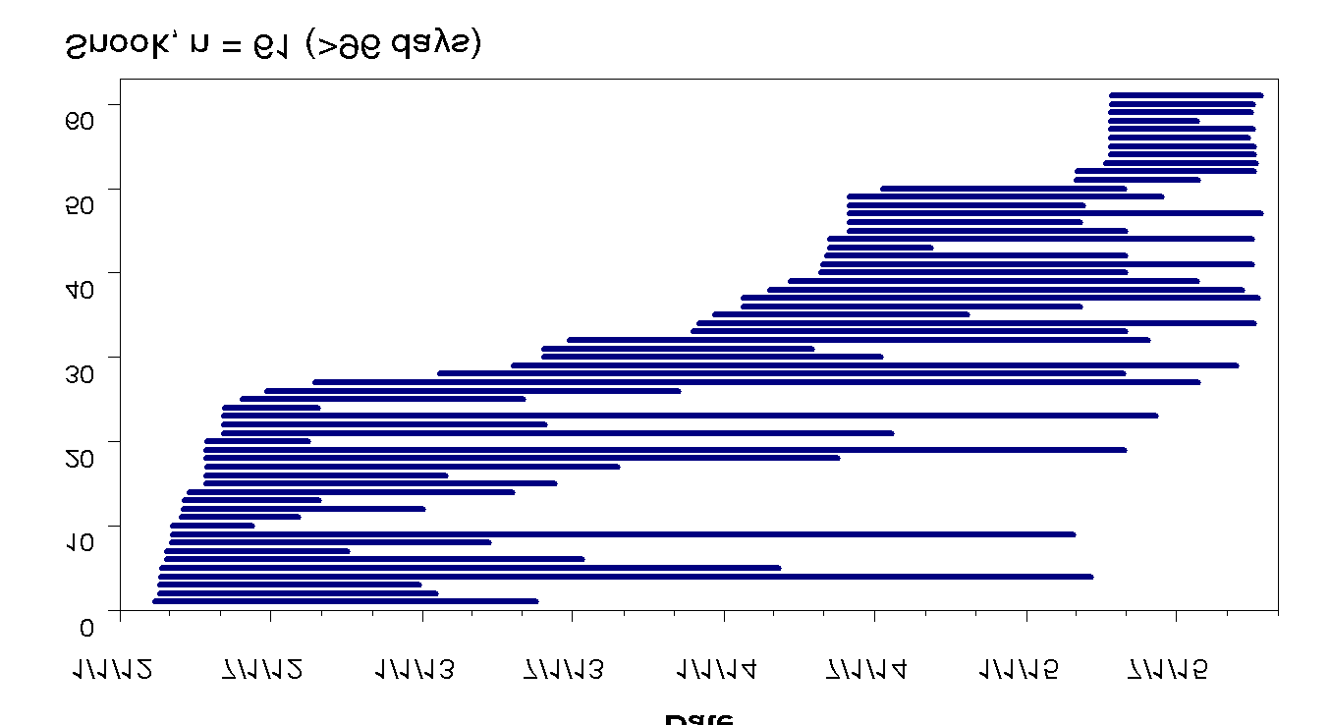
Snook tagging
4 years: 2012-2015
Tagged fish: 45-85 cm length (electrofishing)
90 days minimum detection
N = 60 individuals

Slide 22
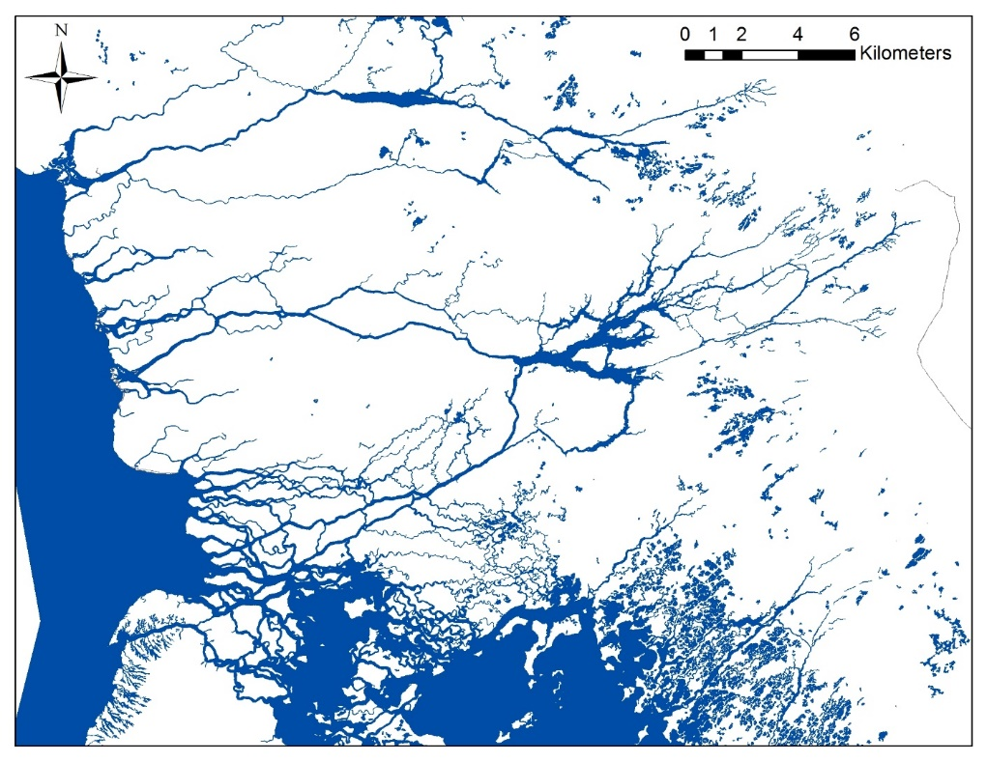
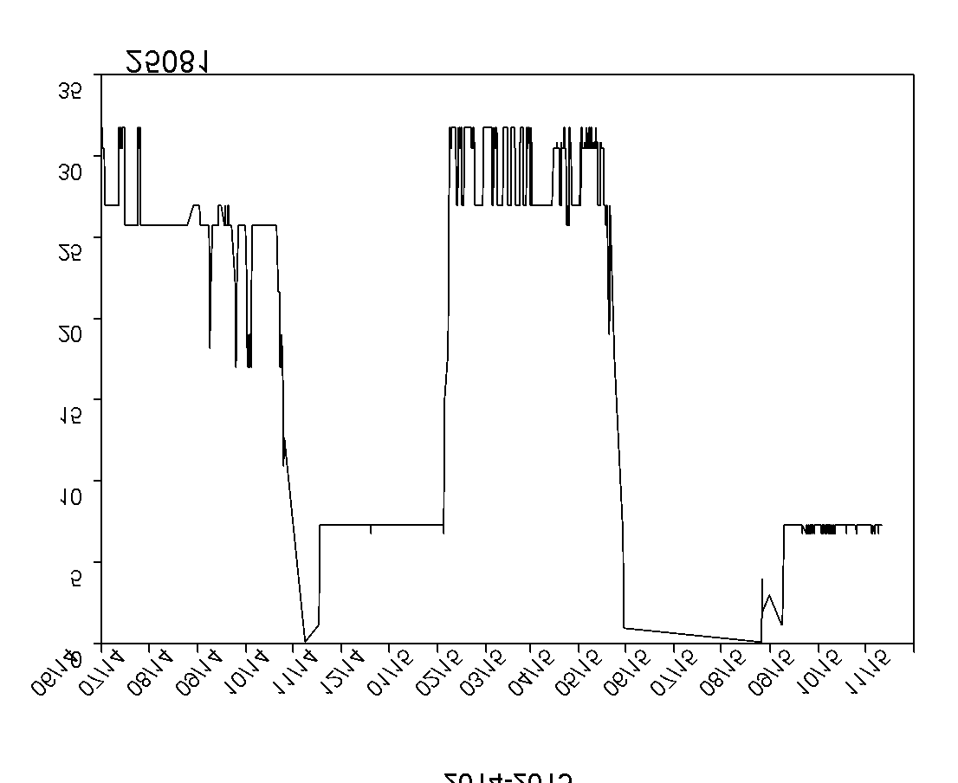
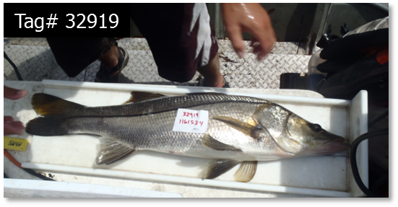
Example of individual movements
Shark River
30 km
32919
0 km
Distance from coast (km)
2014-2015
Notes:
1. What is causing these increases? From acoustic telemetry, we know that for snook these dry season increases are from movement from downstream.
2. Here are detections for one snook as a example.
3. Black dots are detections by one of these receivers in the map as a function of distance from the coast, so the headwaters are up here
4. In the wet season this snook is midestuary, goes to spawn here, but in the dry seasons we find it at the headwaters bothin in 2014, here 2015
Tag 25077

Slide 23
Upstream
0.4
0.0
-0.4
0.4
Bay
0.0
Standardized proportion
-0.4
Downstream
1.0
0.0
-1.0
Apr
Oct
Apr
Oct
Apr
Oct
Apr
Oct
Apr
2012
2013
2014
2015
2016

Slide 24
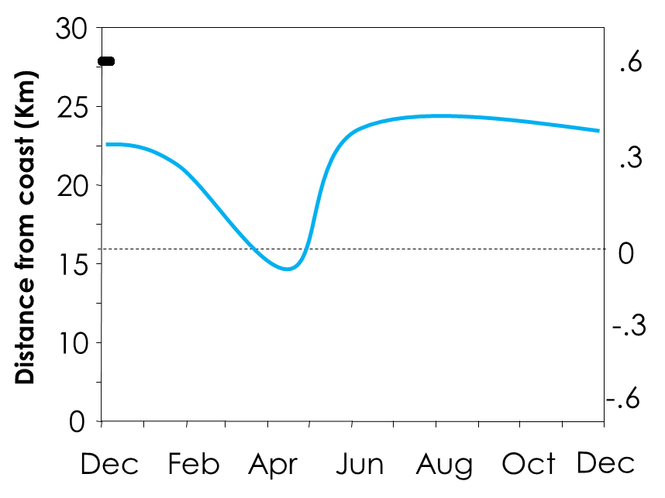
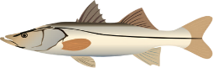

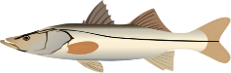

Hypothesis: Seasonal drying should result in upstream movement & high synchrony
30
.6
25
.3
20
Distance from coast (Km)
15
0
-.3
10
Marsh Stage (ft)
-.6
0
Dec
Feb
Apr
Jun
Aug
Oct
Dec

Slide 25
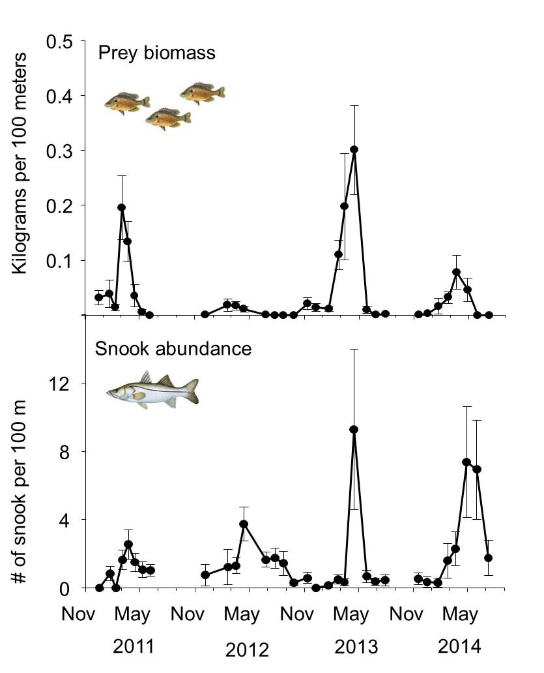
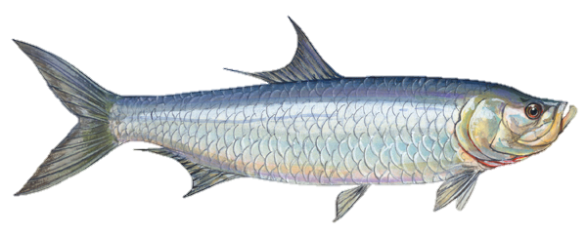
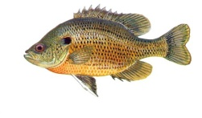
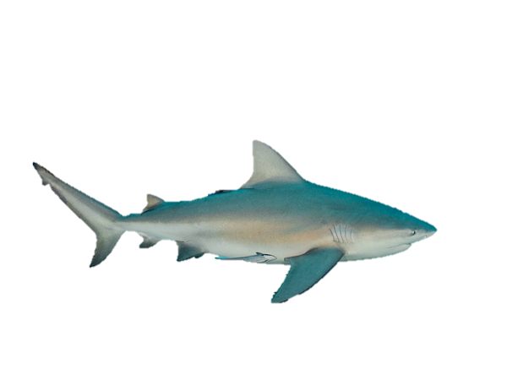
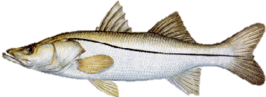
Mechanism: marsh drying causes high-quality foraging upstream in dry season
Upstream
Prey pulse from drying marshes
Drought
Consumers move upstream to forage
Matich et al. 2017 L&O
Boucek et al. 2016 CJFAS Matich et al. 2014 JAE
Boucek & Rehage 2013 Oikos

Slide 26
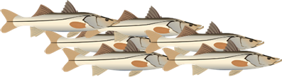
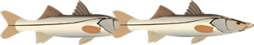
Seasonal variation in level of synchrony
Wet season
Dry season
Proportion of habitat use
Proportion of habitat use
Downstream
Bay
Upstream
Downstream
Bay
Upstream

Slide 27
Seasonal variation in level of synchrony
Wet season
Dry season
Proportion of habitat use
Proportion of habitat use
Downstream
Bay
Upstream
Downstream
Bay
Upstream
Individual variation
Wet season
Dry season

Slide 28
Data analyses
Synchrony over time?
Movement Strategies?
E index
DFA
&
Clustering
E Index
Calculates overlap in resource use
Resources = hydrophones
E = 0-1
(1 = individuals rely on same resources)
Zaccarelli et al. 2014 Methods in Ecol & Evol
Dynamic Factor Analysis
Identify common trends in time-series
Applied to individual tracks
Multidimensional scaling to illustrate clustering of individuals
Notes:
Resource use intrapopulation

Slide 29
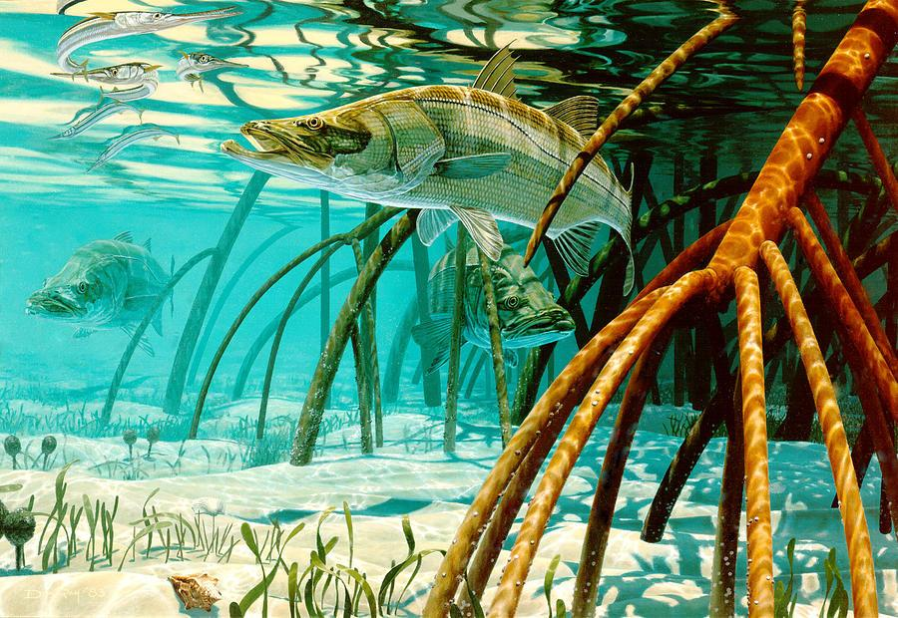
Results: synchrony vs. individual variation?

Slide 30
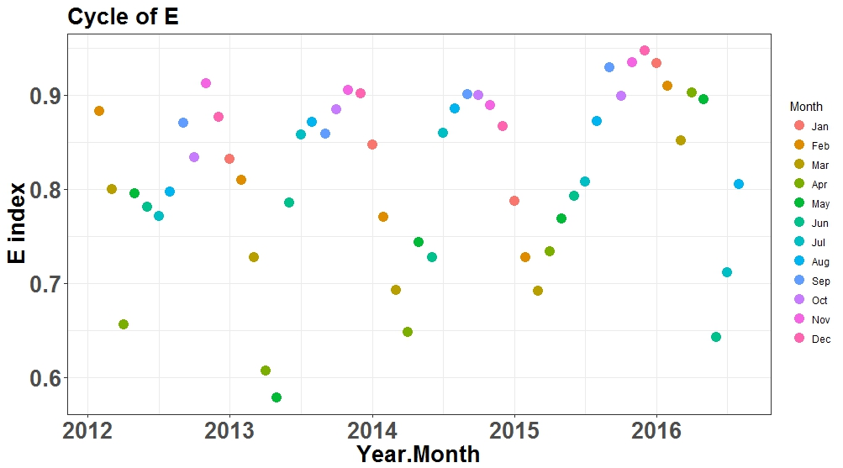
High individual variation (low synchrony) but varies across months
Individual variation
Notes:
To stage

Slide 31
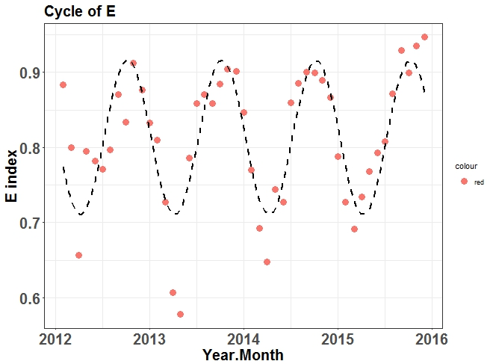
Individual variation cycles similar among years
Individual variation
Notes:
To stage

Slide 32
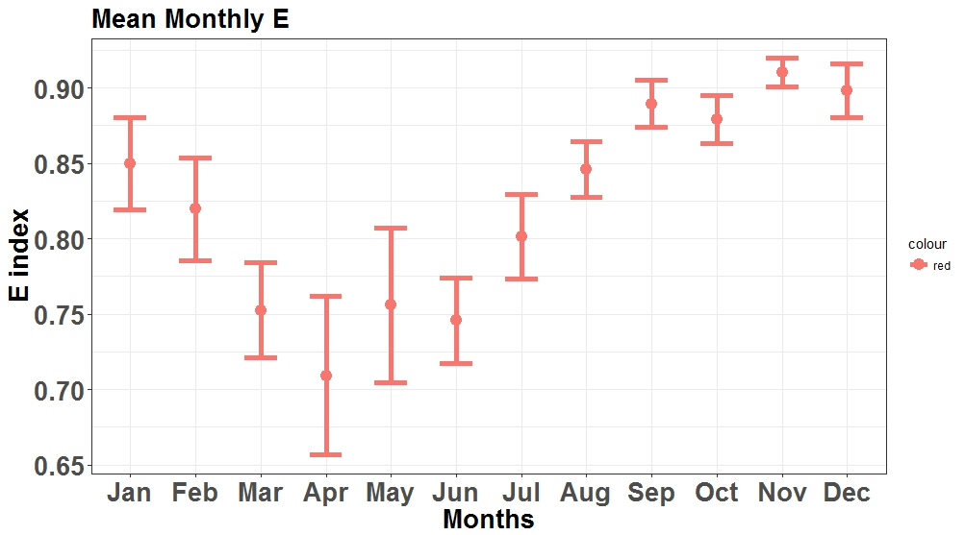
Lowest individual variation (highest synchrony) in dry season
Individual variation
Notes:
Weight by proportion of habitat that is wet

Slide 33
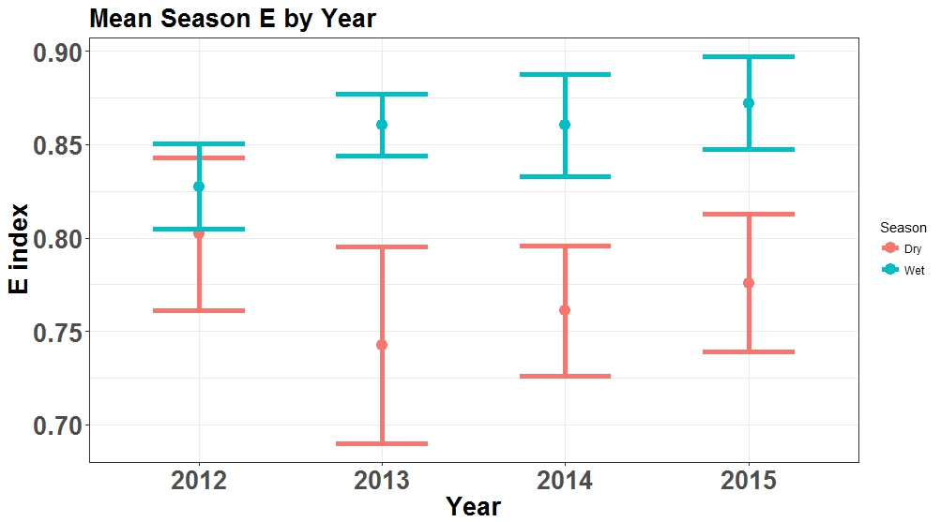
Lower dry season individual variation in most years
Individual variation

Slide 34
Results: Can we identify different movement strategies?

Slide 35
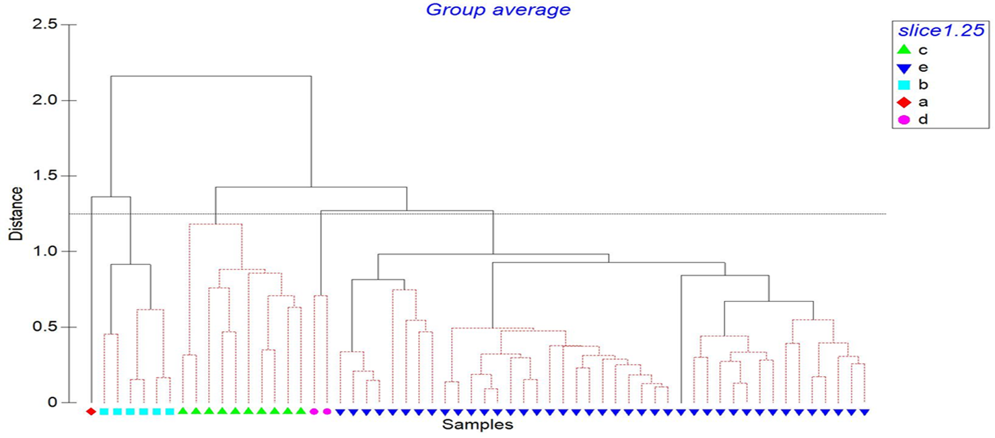
Small number of movement strategies

Slide 36
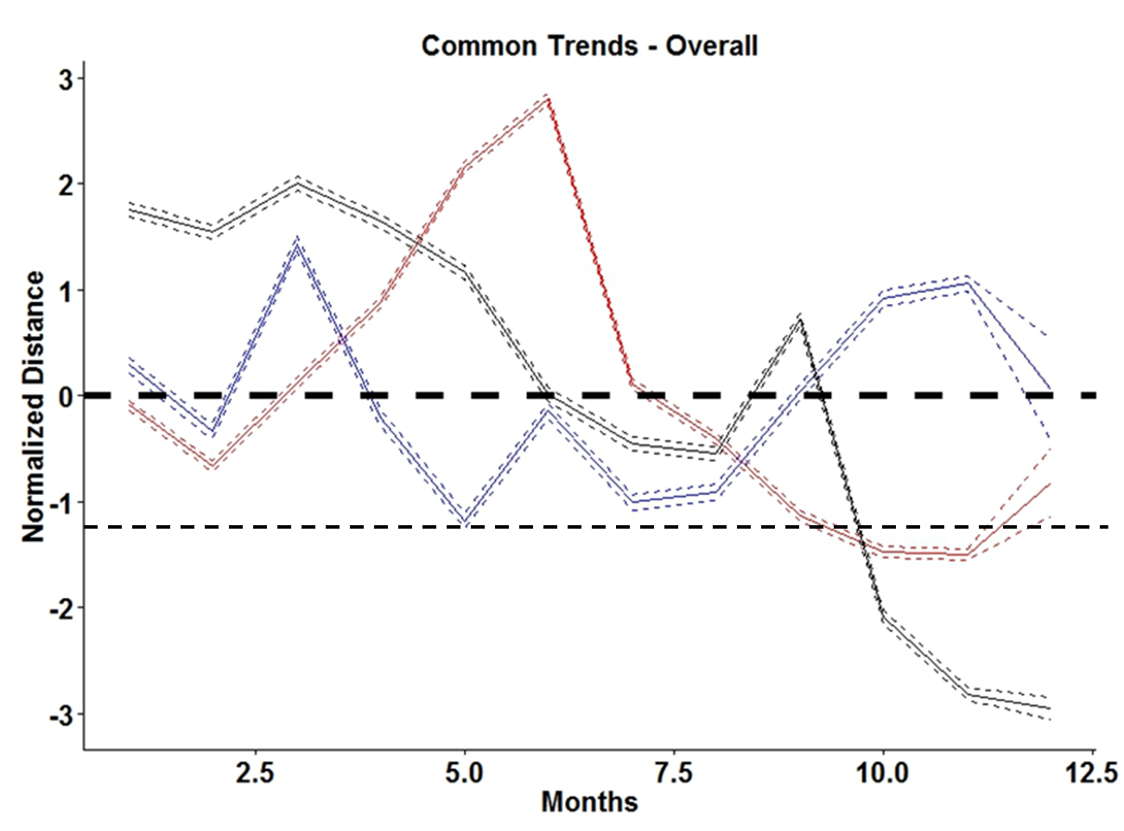
C
3 strategies with varying distances moved
Trackers: Move up & downstream
Intermediate: High movement in upper part of river
Flatliners: Move small distances
Notes:
Deviation from mean distance –
Upstream
add zones

Slide 37
C
3 strategies with varying distances moved
Trackers: Move up & downstream
Intermediate: High movement in upper part of river
Flatliners: Move small distances
Notes:
Deviation from mean distance –
Upstream
add zones

Slide 38
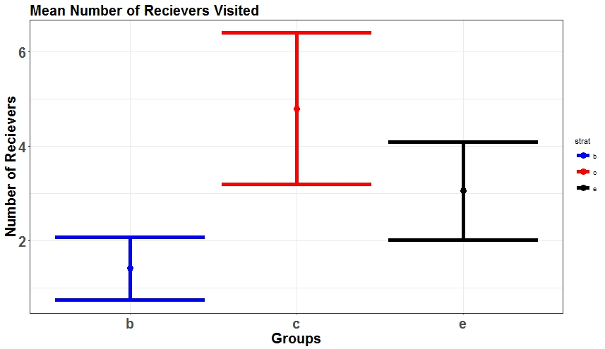
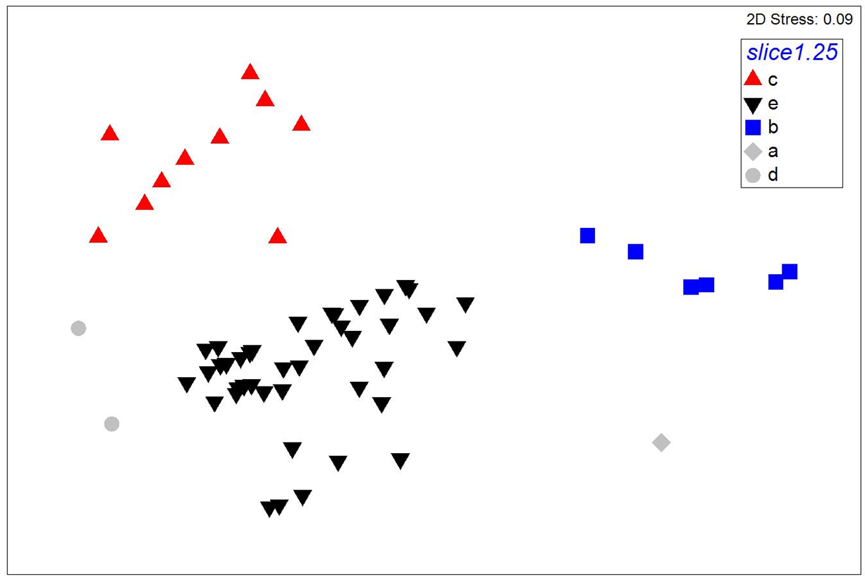
Most individuals are moving, tracking resources
Monthly number receivers visited
Intermediate
Flatliners
Trackers

Slide 39
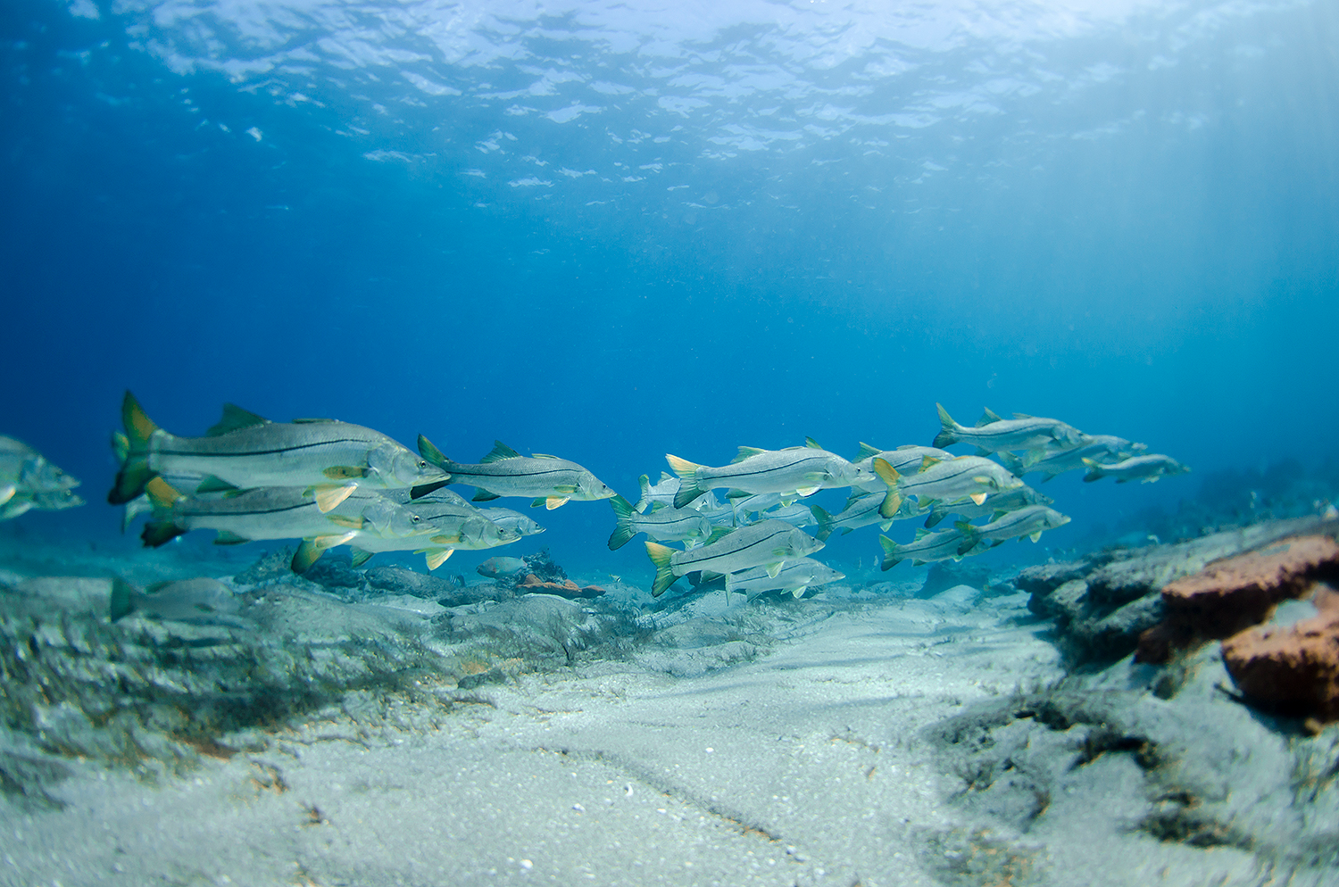
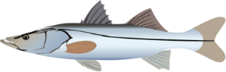

In sum:
High level
of individual variation
Responsive to seasonality
Decreases in dry season -
3 movement strategies: Most individuals move upstream in dry season tracking resource pulse
X_{space}

Slide 40
Significance?
Snook can track resource variation in space & time
Variation in hydrology (natural/management) affects fish distributions & can create hotspots of distribution
Increase vulnerability to stressors
Individual variation can buffer negative effects

Slide 41
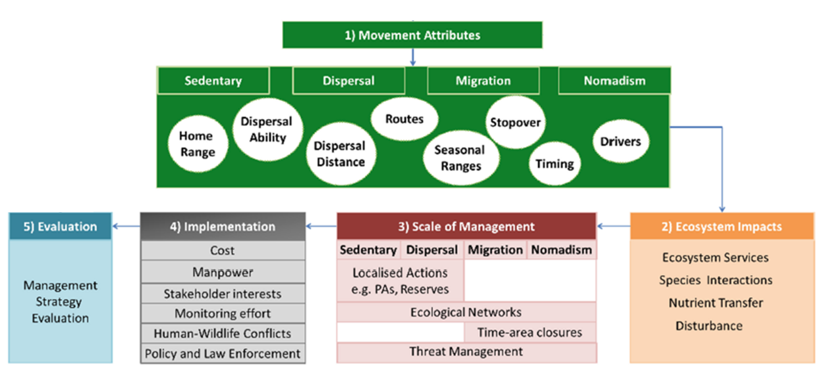
Value of movement data for management
Information can improve effectiveness of management:
Scale of management matches organism
Alternative actions that are flexible in space &time & can be balance other human demands
Time-area based approaches
Allen & Singh 2016 Frontiers in Ecol & Evol
Notes:
Similar to PCA

Slide 42
Thank you!
JS Rehage, RO Santos, RE Boucek
Earth & Environment Department
Notes:
What Is the Role of Individual Variation in Tracking Temporal Heterogeneity? Hydroscapes and Everglades Common Snook

